Slide 1
Spectral Observation of Europa Occulting Io—11 May 2015
Steve Conard
Willow Oak Observatory
33rd Annual Meeting of the International Occultation Timing Association
16-18 October July 2015
Cheyenne Campus of the College of Southern Nevada
North Las Vegas, Nevada

Slide 2
Objective
Investigate use of Alpy spectrometer for temporal events
  Determine what changes would need to be made to both hardware and methods to improve data quality for future similar events
  This was a rather “spur of the moment” observation, and did not have any significant amount of pre-planning

Slide 3
Event Observed
Europa occulting Io
2015 May 11, 01:53:00 to 01:56:26 UT
0.6” minimum distance, expected 0.16 flux drop
Hampered by high cirrus clouds that came through mid-event time
  Early observations were cloud-free

Slide 4
Equipment
Celestron C-14 on CGE mount
Meade 0.33 focal reducer, operating at about 0.4
  EFL of approximately 1565 mm
Alpy 600 spectrometer, with slit jaw camera
  Atik 383L+ (spectra), operated in 2x2 binning mode (5.4 µm native pixels)
  Atik Titan (manual guiding)
  23 µm slit width (14.7 µrad/3.0 arcsec), 3 mm slit length (0.11°)

Slide 5
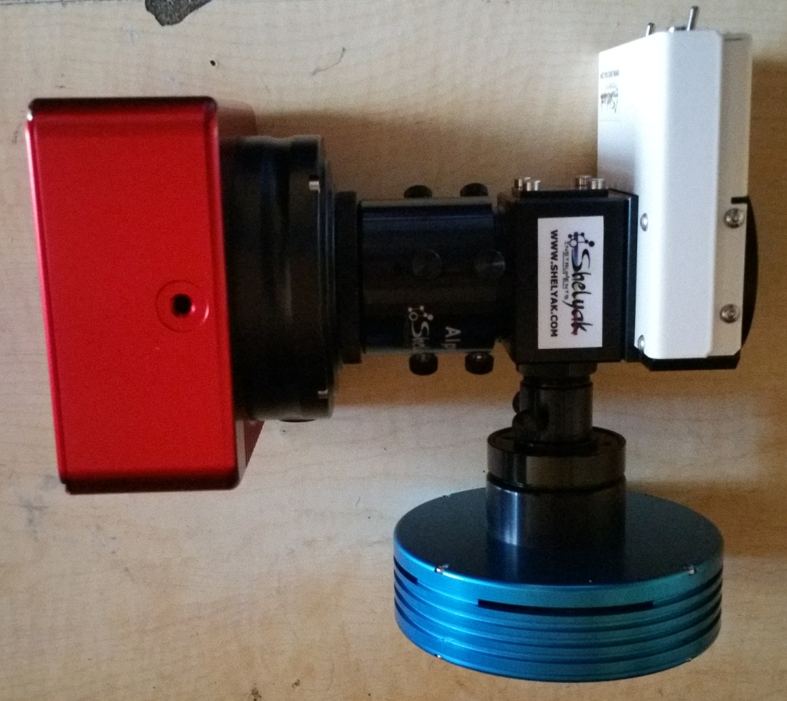
Shelyak Alpy Spectrometer
Telescope Interface
Atik 383L+ Camera
(Spectra)
Alpy Calibration Unit
Alpy Spectrometer
Atik Titan Camera
(Slit Jaw)

Slide 6
Method
Jupiter’s moons very well aligned
  Aligned slit to the moons, although didn’t concern myself strongly with Callisto and Ganymede
    Manually guided across slit only, drift along slit small enough to not be a critical issue
  Note scattered light from Jupiter both inside and outside the two moons, attempted subtraction in analysis
  Integrated for 5 seconds
  Continually collected data for about a half-hour before and after event

Slide 7
Calibration Data
Bias images
  Minimum exposure time, shutter closed
Darks
  Actual exposure time, shutter closed
Flats
  Quartz lamp in Alpy calibration unit, not used in presented data analysis
Wavelength calibration images
  Hg-Ne lamp in Alpy calibration unit

Slide 8
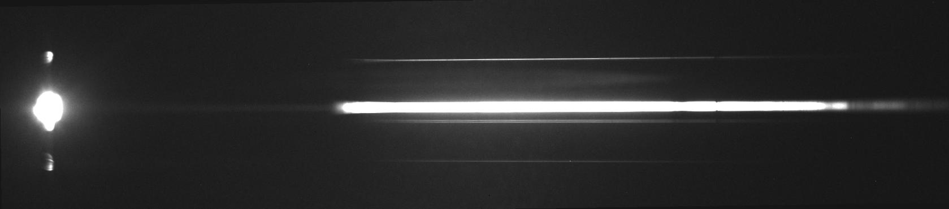
Spectral Image
Zero Order
Spectra
Ganymede
Jupiter
Io / Europa
Callisto
Increasing Wavelength
On following charts, WL (nm) = bin*0.590+309

Slide 9
Well-Separated--~01:35:30
-19:13
400 500 600 700 800 nm

Slide 10
Well-Separated--~01:35:30
-19:13
400 500 600 700 800 nm

Slide 11
Well-Separated--~01:35:30
-19:13
400 500 600 700 800 nm

Slide 12
Merged--~01:43:10
-11:33
400 500 600 700 800 nm

Slide 13
Merged--~01:45:30
-09:13
400 500 600 700 800 nm

Slide 14
Merged--~01:47:20
-07:23
400 500 600 700 800 nm

Slide 15
Merged--~01:49:45
-04:58
400 500 600 700 800 nm

Slide 16
Merged--~01:51:55
-02:48
400 500 600 700 800 nm

Slide 17
Merged--~01:53:05
Occultation Start
400 500 600 700 800 nm

Slide 18
Merged--~01:54:45
Mid-Occultation
400 500 600 700 800 nm

Slide 19
Merged--~01:56:30
Occultation End
400 500 600 700 800 nm

Slide 20
Merged--~01:58:55
+04:12
400 500 600 700 800 nm

Slide 21
Conclusions
Clouds significantly impacted the signal level near central event time
The slit, with the relatively poor tracking of my mount, is too narrow to produce meaningful results
As the spectral resolution is most likely overkill for this type of event, a wider slit is a possible solution
  Sheylak is now making a “Photometric” slit for the Alpy, new slit received but not yet installed
  1 mm of length is widened to 300 µm, which should allow me to keep all the light inside the slit in the future
Jupiter contributed a great deal of stray light to the observation, and there likely are better ways to attempt to minimize it in the data analysis

